Slide 1
The Typical artificial neural networks

Slide 2
Perceptron neural network
Back-Propagation neural network
Radial basis function neural network

Slide 3
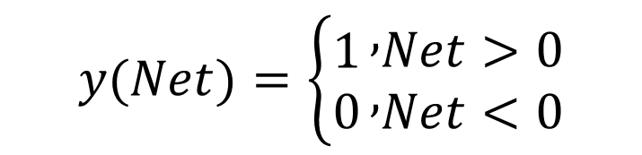

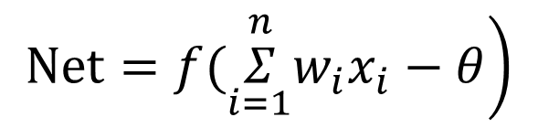

Perceptron neural network
Single neuron perceptron is an early neural network model proposed by an American scholar in 1957.
$$x_{1}$$
。。。
$$x_{n}$$
The perceptron processing unit weights and operates on n inputs.
$$\left.Net=f(\overset{n}{\underset{i=1}{Σ}}w_{i}x_{i}−θ\right)$$
$$y(Net)=\left\{\begin{matrix}1 \\ 0\end{matrix}\right.\begin{matrix}, \\ ,\end{matrix}\begin{matrix}Net>0 \\ Net<0\end{matrix}$$

Slide 4


function
pattern recognizer
Implementation of logical functions
$$Net=2x_{1}+2x_{2}−1$$
When x1=x2=0,Net<0,y(Net)=0
When either x1 or x2 is equal to 1,Net>0 is always establish, so y(Net)=1.

Slide 5
Advantages and limitations
Advantages
Perceptron model is simple and easy to implement
limitations
It can’t implement “xor” operation
It can only solve linear separable problem

Slide 6
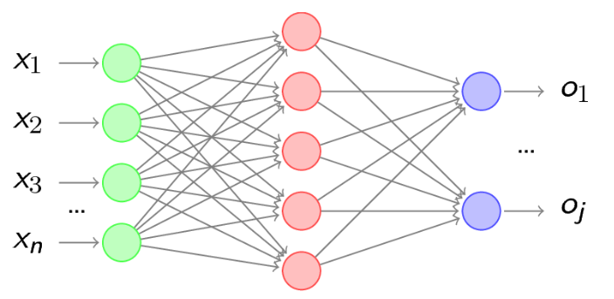
Back-Propagation neural network
BP (Back Propagation) neural network is a neural network learning algorithm. It is composed of input layer, intermediate layer and output layer.

Slide 7
function
Function approximation
pattern recognition
classification
data compression

Slide 8
Advantages
Strong ability of nonlinear mapping
It has the ability of associative memory of external stimuli and input information
It has a strong ability to recognize and classify external input samples
Ability to optimize computation

Slide 9
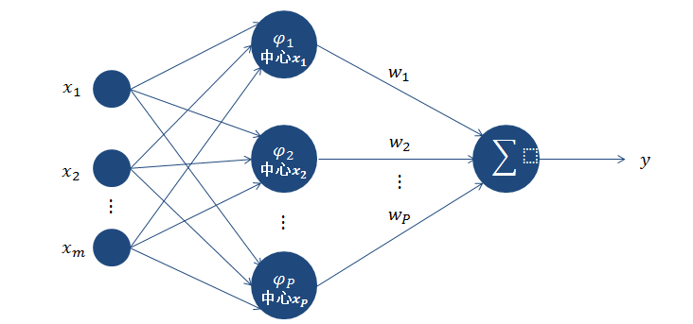
Radial basis function neural network
Radial Basis Function (RBF - Radial Basis Function) neural network is made up of J.M oody and C.D arken presented in the late 80 s as a kind of neural network.

Slide 10
Advantages
It has the unique best approximation characteristics, and there is no local minimum problem.
RBF neural network has strong input and output mapping function
Network connection weight and output linear relationship
Good classification ability.
The learning process converges fast

Slide 11
THANK YOU

